Slide 1

Interim Progress: Adversarial Geometric Distillation
Mitigating Hallucinations and the Janus Problem in 3D Model Generation

Slide 2

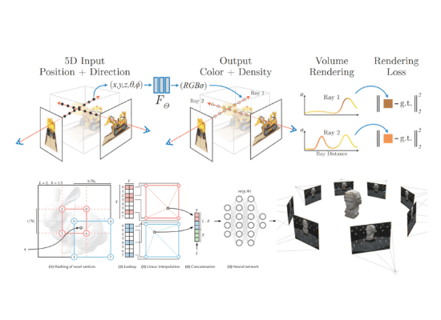
Background: Text-to-3D Synthesis
•
The field evolved from optimization-based reconstruction to zero-shot synthesis utilizing Neural Radiance Fields (NeRF) and Score Distillation Sampling (SDS).
•
SDS utilizes a pretrained 2D diffusion model to provide gradients for a 3D model by minimizing noise differences.
•
While enabling high-fidelity synthesis, these pipelines operate purely in 2D pixel space, missing crucial 3D structural awareness.

Slide 3
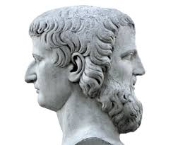
The Janus Problem & Hallucinations
•
Mode Collapse: 2D diffusion models are biased toward frontal views. SDS optimization often settles into these high-probability 2D viewpoints.
•
This creates the Janus Problem: generating multi-faced artifacts or redundant limbs on a single object.
•
Other topological errors include floating components (Betti number > 1), unintended handles (genus > 0), and disconnected geometry.

Slide 4






Literature Review: SOTA Limitations
Magic3D / Fantasia3D
Perp-Neg & Entropic SDS
Hallo3D
Focuses on high-res geometry and disentangling appearance. However, the generative priors remain fundamentally "geometry blind".
Attempt mathematical debiasing in score-space, but fail to explicitly understand if the output structure is anatomically correct.
Introduces multimodal detection. Converts spatial errors into textual feedback ("negative prompts"), losing critical spatial precision.

Slide 5


Defining the Research Gap
1. Geometry Blindness
2. The Semantic Bottleneck
The optimization objective for 3D generation lacks a geometric energy term defined directly on the mesh's topological and spectral properties. Gradients reshape 2D pixels, not 3D manifolds.
Frameworks like Hallo3D map spatial hallucinations into natural language. This many-to-one lossy compression discards exact vertex coordinates, leading to over-correction or new artifacts.

Slide 6
Research Objectives
1. Literature Review Analyze the evolution of geometric hallucinations and how specific topological errors manifest in modern generative 3D models.
2. Method Study Examine adversarial neural networks and self-distillation technologies used for automated artifact detection and mesh refinement.
3. System Design Develop an Adversarial Geometric Distillation (AGD) framework that integrates an auxiliary AI critic to correct 3D anomalies without text prompts.
4. Evaluation Assess performance using quantitative geometric metrics (surface smoothness, manifold quality) against baseline SOTA models.

Slide 7
The AGD Hypothesis
Replacing imprecise textual feedback with direct geometric grounding will eliminate structural inconsistencies and ensure exact topological integrity in zero-shot synthesis.

Slide 8
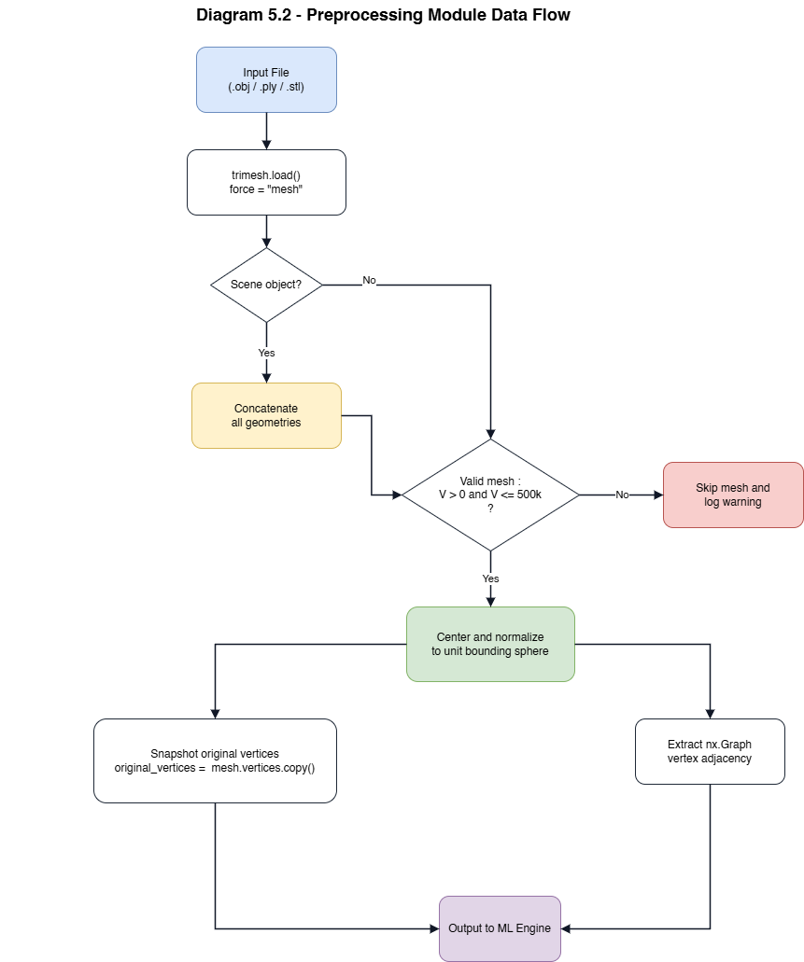
System Architecture
•
1. Preprocessing Module: Normalizes meshes and extracts adjacency graphs.
•
2. ML Engine: Fuses signals from a topological Discriminator, a GNN-based Critic, and an LMM multi-view inspector (LLaVA-v1.6).
•
3. Extended Module: Projects numerical severity scores into explicit vertex weights, driving the grounded refinement optimization.

Slide 9


Pipeline: Ingestion & Rendering
Stage 1: Pre-processing
Stage 2: Dense Multi-View Rendering
Loads raw meshes via Trimesh. Meshes are centered and normalized to a unit bounding sphere. Vertex normals are computed, and the adjacency graph is extracted as a sparse matrix for downstream spectral analysis.
A pure-NumPy software rasterizer captures N views (e.g., 36) using Fibonacci-sphere distribution. Each viewpoint renders 5 specific buffers: RGB, Depth, Normal Map, Silhouette, and Edge/Curvature map.

Slide 10



Pipeline: Detection & Critic
Stage 3: LMM Detection
Stage 4: Adversarial Geometric Critic
LLaVA v1.6 inspects RGB buffers, outputting a numerical severity score [0,1] for spatial errors. Critically, we discard natural language notes and strictly ingest the numerical bias to avoid semantic loss.
Computes global scores analyzing Laplacian eigenvalue variance. We extract exact algebraic topological invariants like the Euler Characteristic:
This allows absolute mathematical validation of handles and loops.

Slide 11
Pipeline: Geometric Grounding
Mapping Views to Vertices
3D
The grounding module solves the core research problem. It projects 2D severity scores back onto specific vertices by calculating projection distance and normal vector alignment. This fuses LMM bias with the GNN critic anomaly scores into a unified, high-precision vertex weight map.
SPATIAL PRECISION

Slide 12

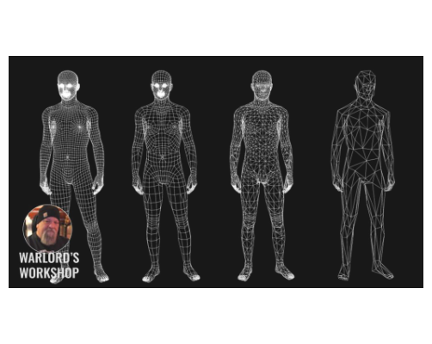

Pipeline: Grounded Refinement Loop
Iteratively updates vertex positions using an energy minimization loop guided by the grounded weight map.
The distillation anchor term D(v) guarantees theoretical boundedness, ensuring the mesh doesn't drift into degenerate geometry during Laplacian smoothing.

Slide 13






Technology Stack
Geometry & Compute
Machine Learning
Vision Language
Python forms the base, utilizing Trimesh for mesh loading/topology and NumPy/SciPy for custom multi-view software rasterization and sparse Laplacian eigenvalues.
PyTorch and PyTorch Geometric construct the GCN Critic. Allows for dynamic, gradient-based anomaly scoring directly on graph edge indices.
Local deployment of LLaVA-v1.6 (via HuggingFace) executes hardware-accelerated multimodal inspection across 36+ generated viewpoints.

Slide 14
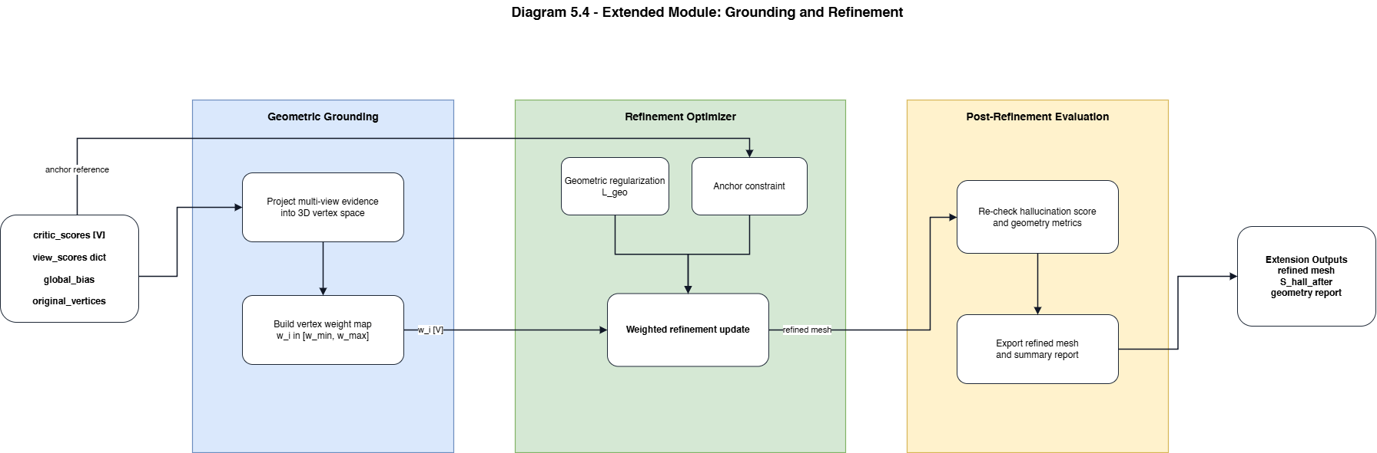
Experiments Conducted
•
Iterative mathematical validation was performed on a highly curated dataset consisting of 21 test meshes.
•
Evaluated against Objaverse baseline outputs. Successfully corrected explicitly hallucinated models (Janus faces, duplicated limbs).
•
Developed continuous integration "smoke tests" bypassing the heavy LMM module to guarantee the mathematical stability of the Laplacian solvers during code refactoring.

Slide 15




Progress & Timeline
Q2 - ML Engine
Q4 - Final Eval
Implemented the Heuristic Critic, Discriminator, and LMM integrations.
Execution against large-scale GSO datasets and benchmark reporting.
Q1 - Foundations
Q3 - Optimization
Designed the Metric Framework and analyzed topological baseline errors.
[Current] Built Geometric Grounding module and iterative refinement loops.

Slide 16
Questions?
Thank you for your time.

